Slide 1

Metaverse Classroom AWT - Developing Metaverse Experiences
Tarik Moussa Salama, Jacopo Ceravolo, Furkan Tas, Joao Lucas Mendes de Lemos Lins

Slide 2
Recap

Slide 3
FIRST PRESENTATION STARTING FROM HERE

Slide 4
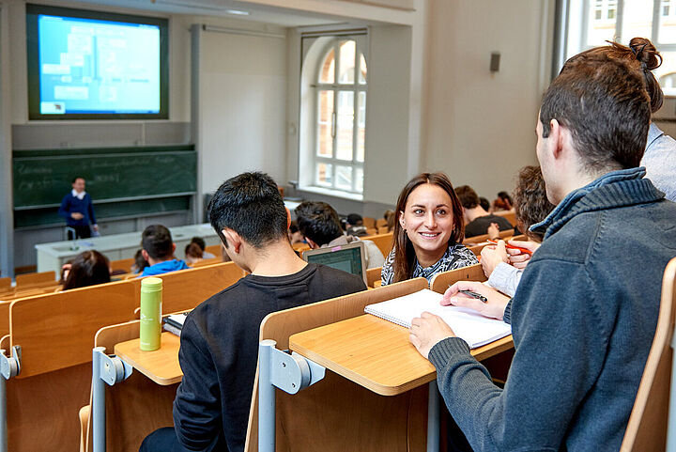
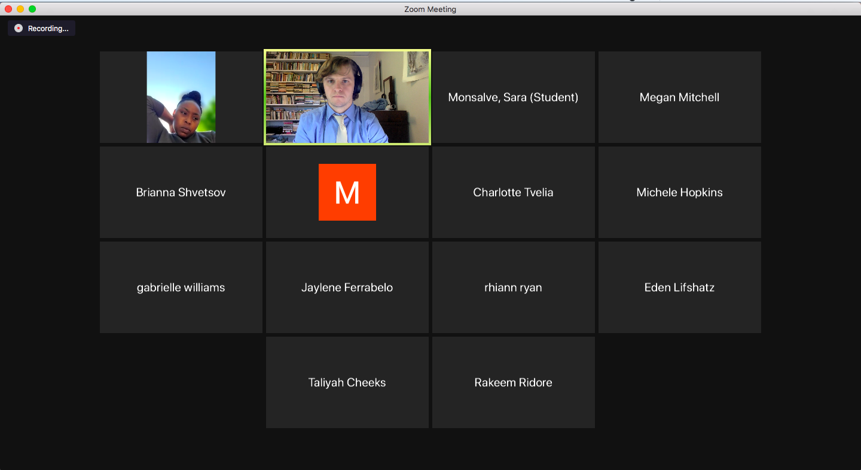
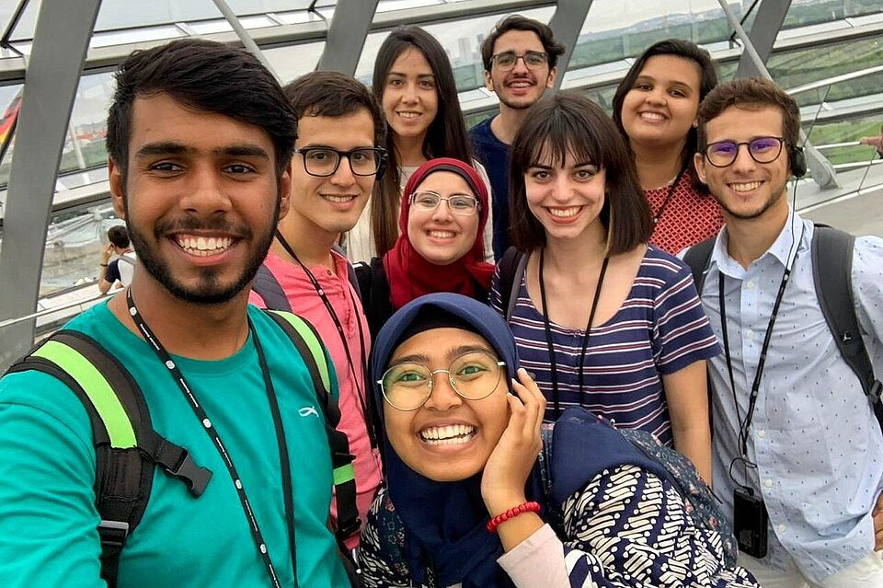

Motivation
https://aicyellowjacket.com/7816/editorial/should-cameras-be-on-or-off-on-zoom/# (last accessed 16.11)
Images taken from TU Berlin website (tu.berlin)
© Philipp Arnoldt
© TU Berlin/PR/Oana Popa-Costea
© Yash Preet

Slide 5
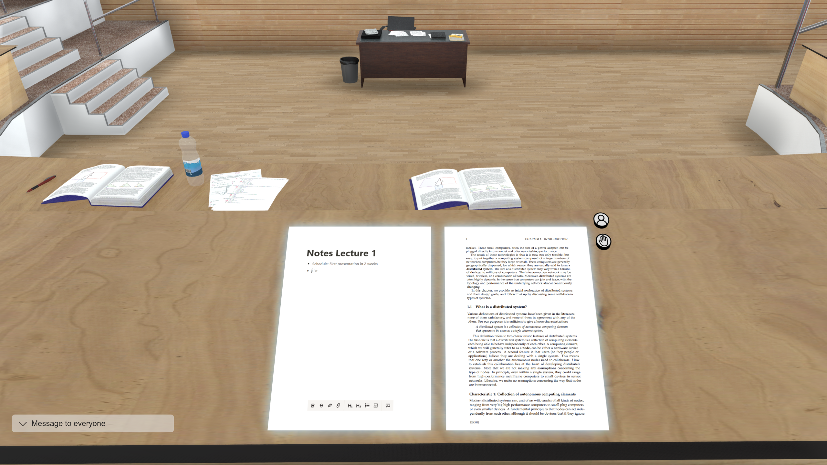
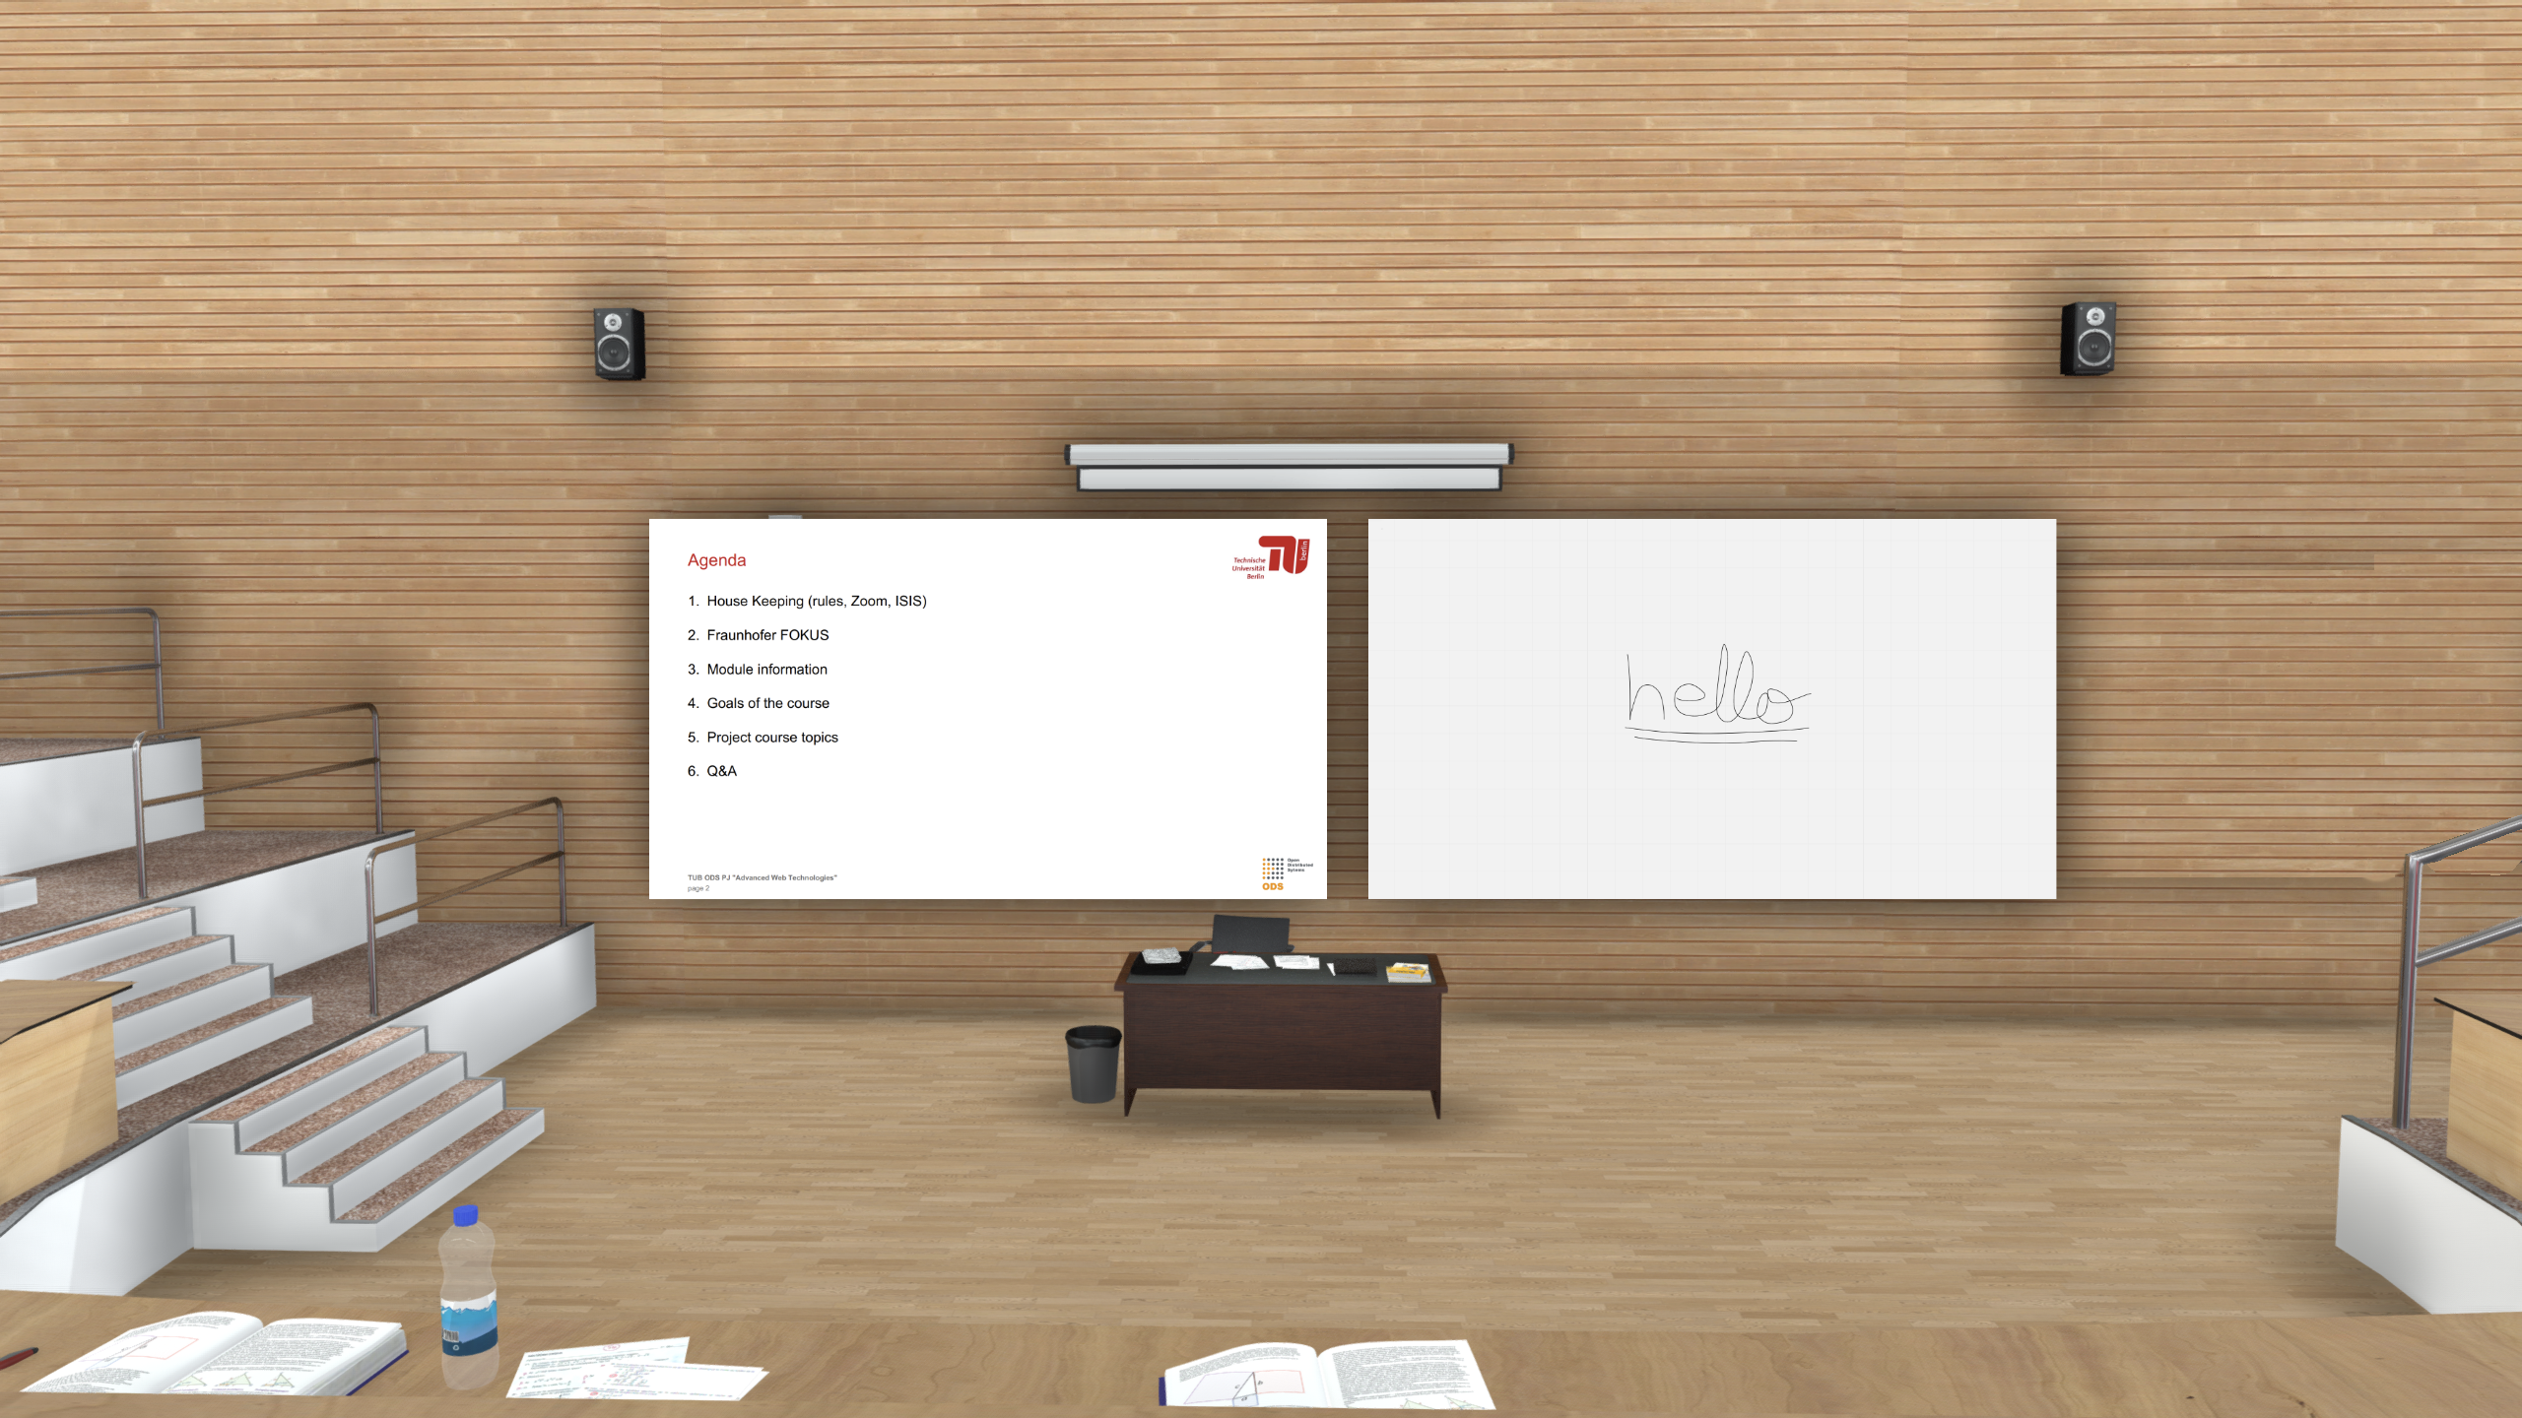
Motivation
Students
Can take notes
View a document in parallel
Have chat functionality
Teacher
Has a whiteboard
Can present slides
Has private presenter notes
Both
Video and audio capabilities

Slide 6
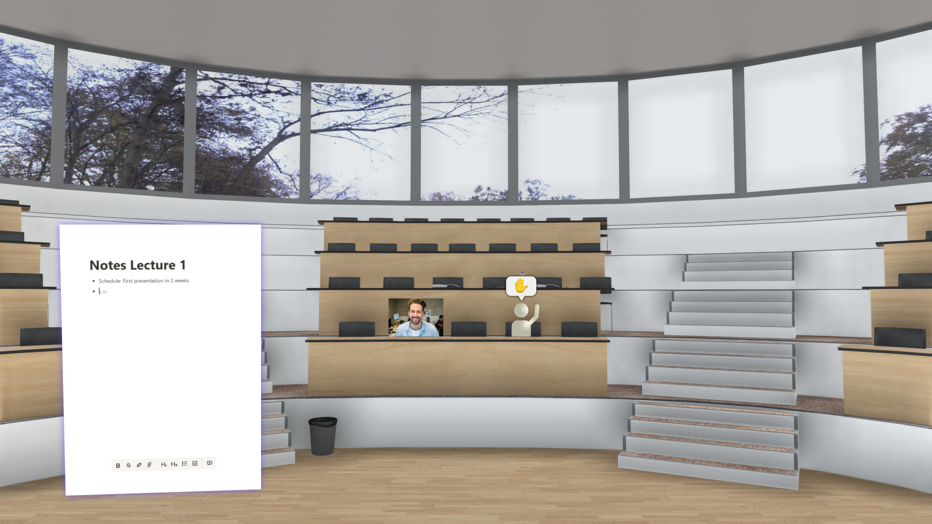
Motivation
Students
Can take notes
View a document in parallel
Have chat functionality
Teacher
Has a whiteboard
Can present slides
Has private presenter notes
Both
Video and audio capabilities

Slide 7
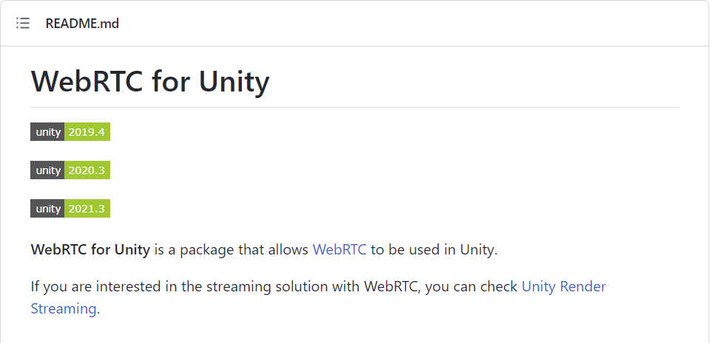
Features – Webcam & Microphone
Ability to enable or disable webcam
Automatically toggle between avatar and webcam

Slide 8
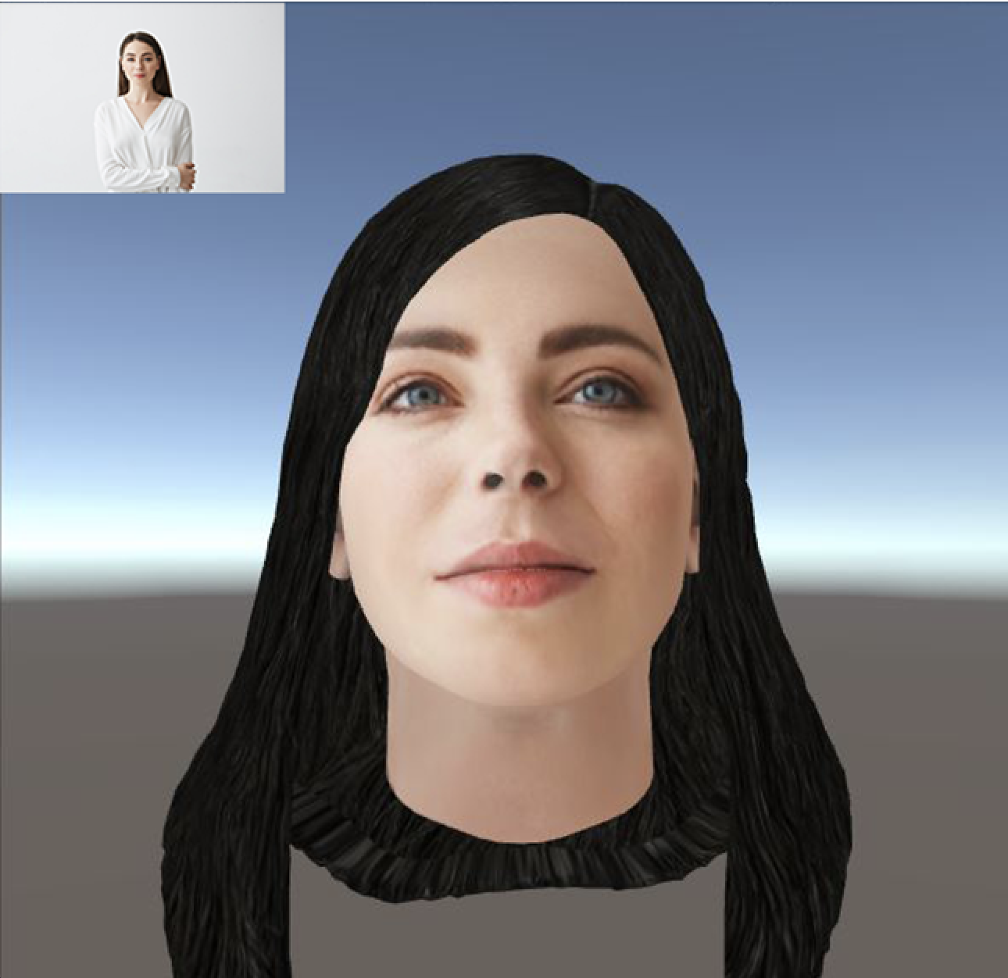
Features – Avatar Customization
Photorealistic avatars created from personal photo
Possibility of customization of hair styles and facial expressions
Ready Player Me Unity SDK or Avatar Maker

Slide 9
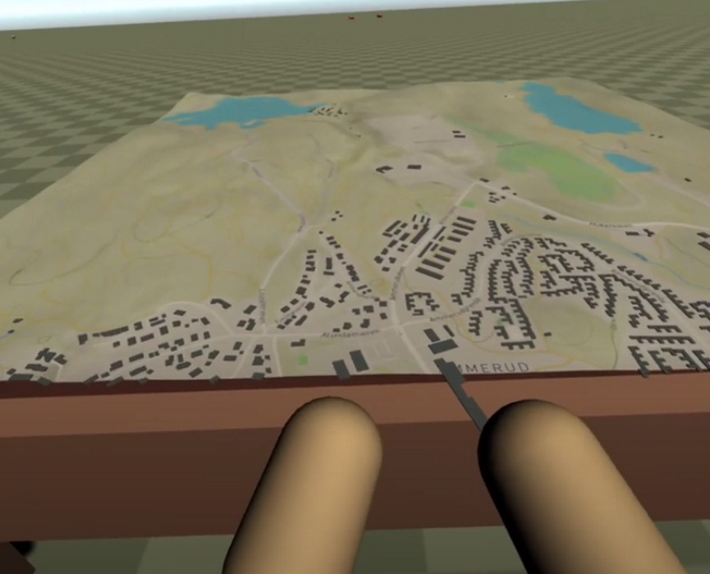
Features – 3D Classroom
3D classroom environment
Interactions with seats and desk
Possibility to focus on a portion of the environment
Possibility to change environment according to class subject

Slide 10
Features – Personal Space
Realized as a 2D UI in world space
Embedded in the desk of the student
Divided into personal notes and PDF reader section
Notes:
https://docs.unity3d.com/Packages/com.unity.ugui@1.0/manual/HOWTO-UIWorldSpace.html

Slide 11
Features – Screen Sharing
Realized as a 2D UI in world space
Embedded in at the front of the room
Divided into personal notes and lecture slides
Notes:
https://docs.unity3d.com/Packages/com.unity.ugui@1.0/manual/HOWTO-UIWorldSpace.html

Slide 12
Features – Nonverbal Feedback
Two different Version for avatar or webcam
Avatar Animation: Deepmotion
Webcam: 2D UI in World Space
Notes:
https://docs.unity3d.com/Packages/com.unity.ugui@1.0/manual/HOWTO-UIWorldSpace.html

Slide 13
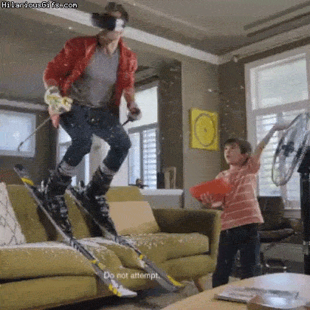
VR – Challenges
Committing to the VR introduces a series of challenges that complicate the scope of the project
In VR many simple interactions have to be rethought to fit the medium
Notes:
https://docs.unity3d.com/Packages/com.unity.ugui@1.0/manual/HOWTO-UIWorldSpace.html

Slide 14
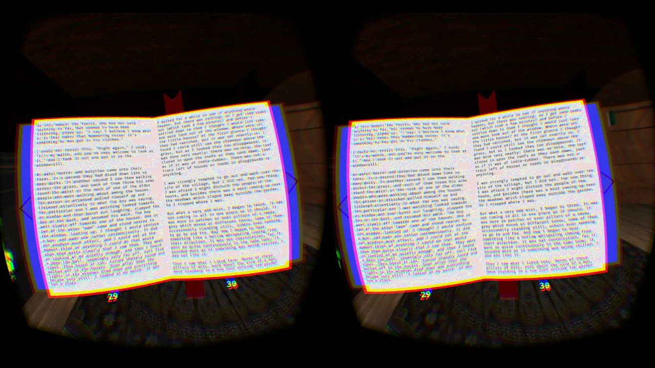
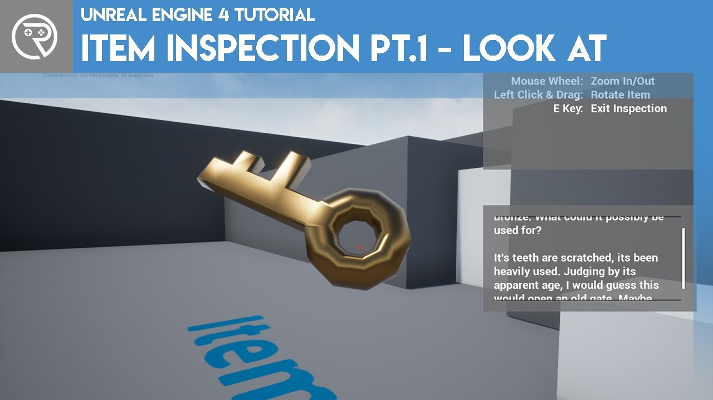
VR – Challenges
Reading in VR can be difficult in some old headsets
Proposed solution: Focus mode
Notes:
https://docs.unity3d.com/Packages/com.unity.ugui@1.0/manual/HOWTO-UIWorldSpace.html

Slide 15
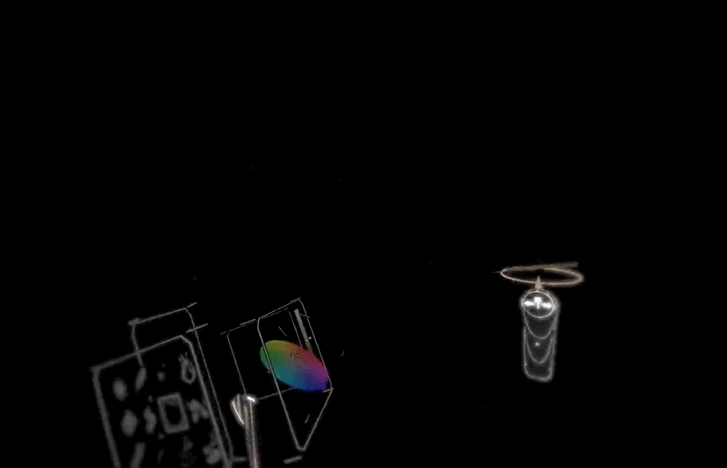
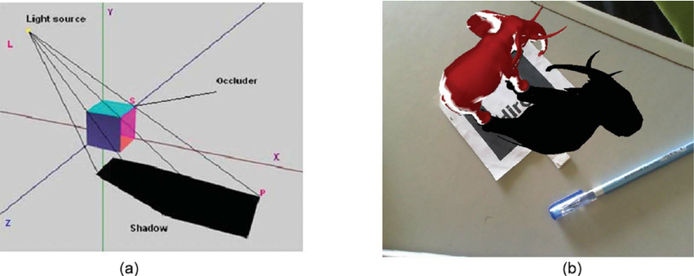
VR – Challenges
Writing in VR is a beast of its own
Proposed solution 1: Embrace it
Proposed solution 2: Project it
Notes:
https://docs.unity3d.com/Packages/com.unity.ugui@1.0/manual/HOWTO-UIWorldSpace.html

Slide 16
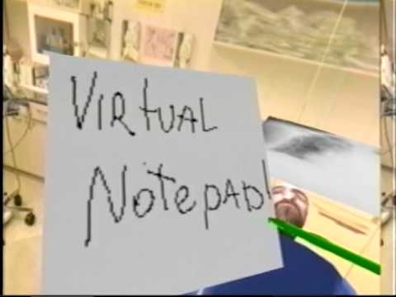
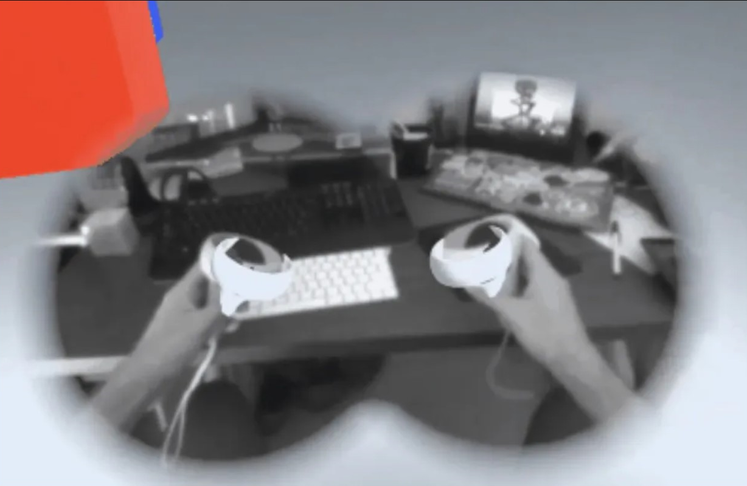
VR – Challenges
Typing and Note-taking in VR is difficult
Proposed Solution: Partial Passthrough
Notes:
https://docs.unity3d.com/Packages/com.unity.ugui@1.0/manual/HOWTO-UIWorldSpace.html

Slide 17
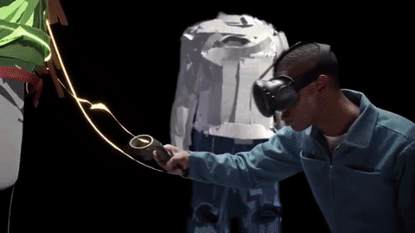
VR – Final Words
The potential is too great to not explore
Many of these challenges have already been solved and packaged in libraries and plugins
It seems really fun!
We are thus committed to the idea
Notes:
https://docs.unity3d.com/Packages/com.unity.ugui@1.0/manual/HOWTO-UIWorldSpace.html

Slide 18
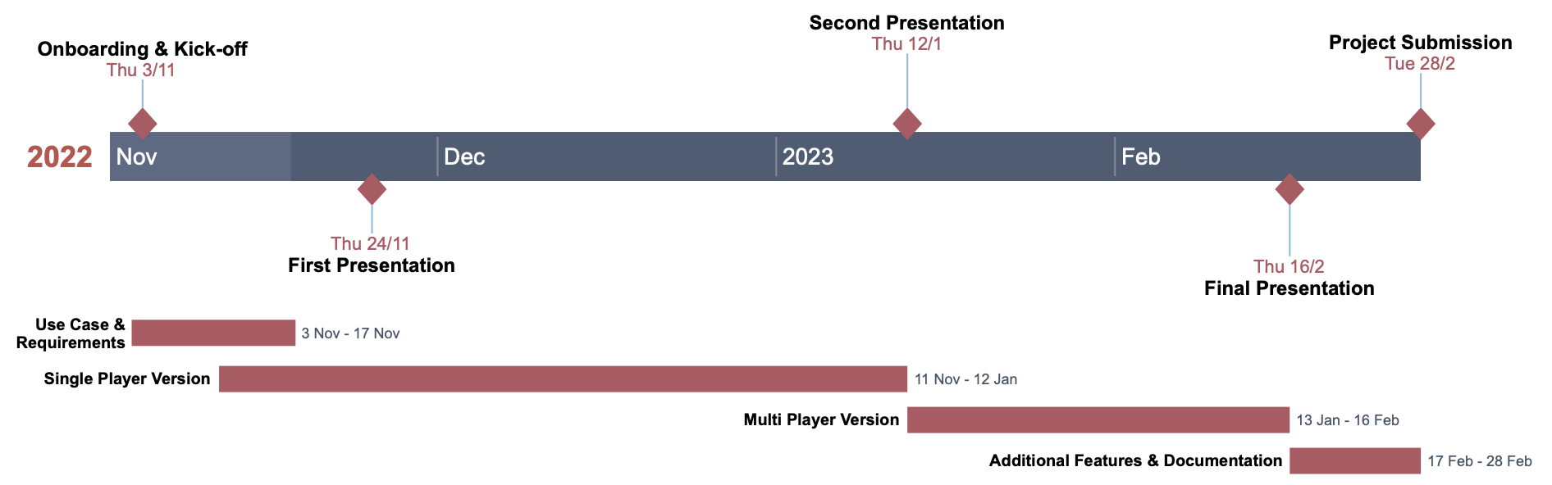
Roadmap

